Slide 1
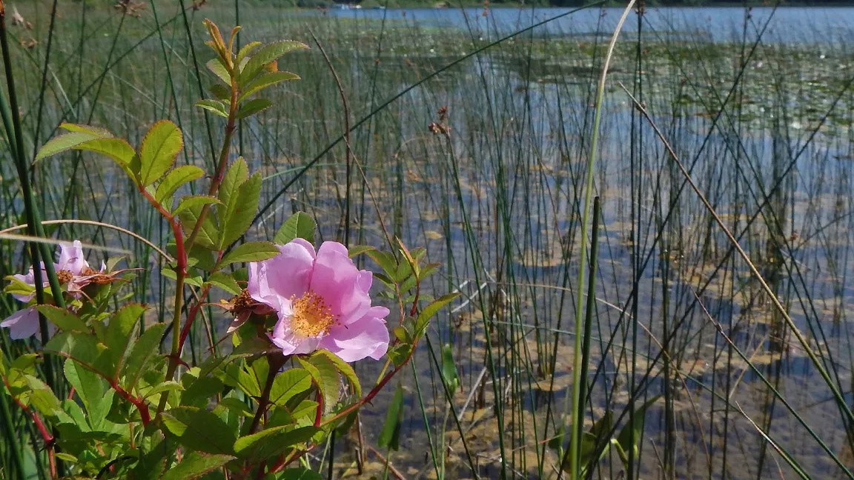
Plant Taxonomy Flower Diversity 1

Slide 2
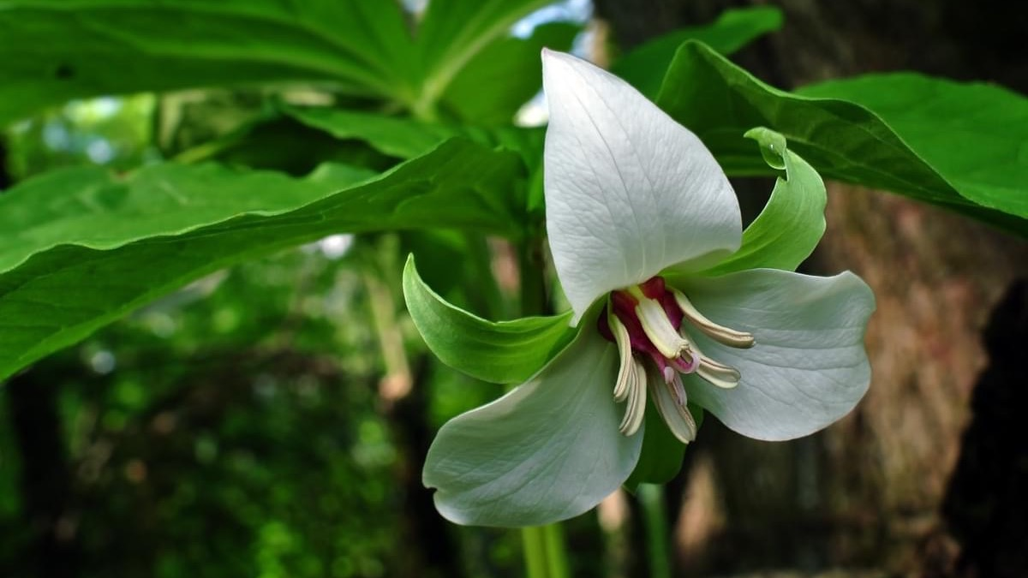
How many parts?
Floral formula?

Slide 3
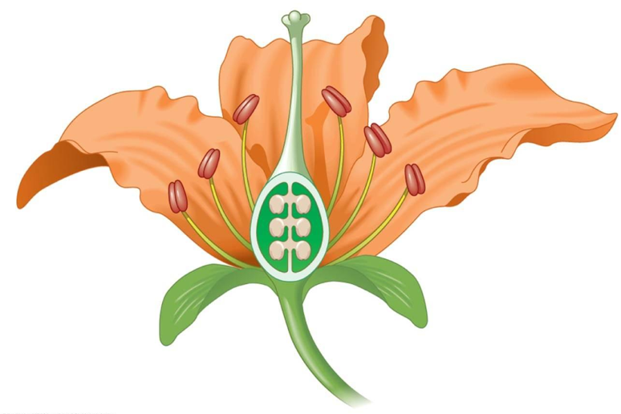
Floral organs
Whorled or spiral?
What names do we use for parts of each whorl?
B
A
C
D

Slide 4
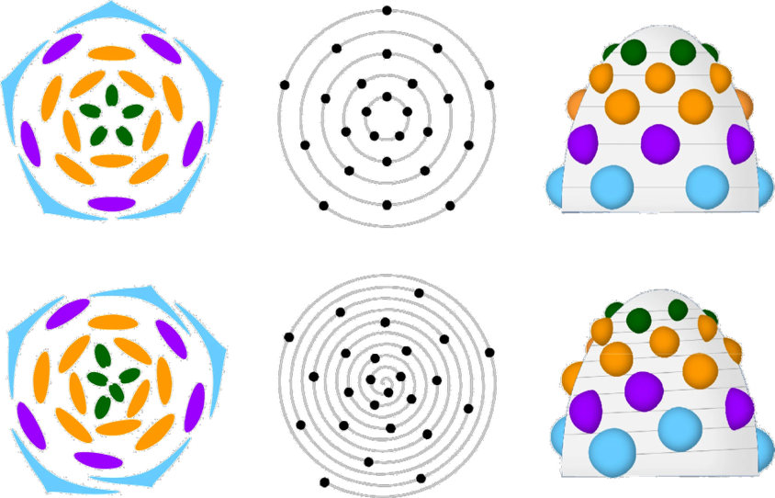
From whorls to spirals
Whorled:
(two whorls of stamens)
Spiral:
Top-down diagram of organs
Top-down diagram of organ positions
Side-view diagram of organs
https://doi.org/10.1038/nplants.2015.188

Slide 5
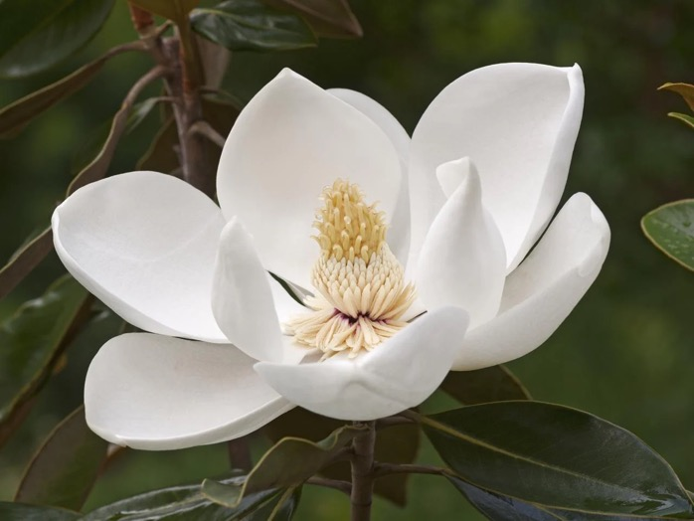
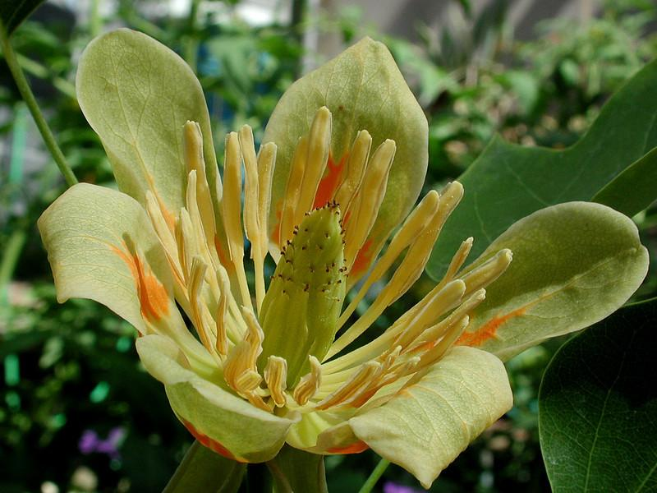
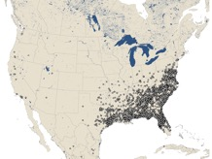
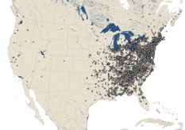
Magnoliaceae (magnolia family)
P ∞ A ∞ G ∞
Spiral perianth, androecium, gynoecium
Native to North America, not quite Wisconsin
Magnolia
Magnoliaceae
Tulip-tree
Liriodendron
Magnoliaceae

Slide 6
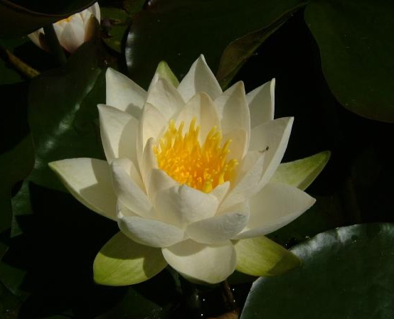
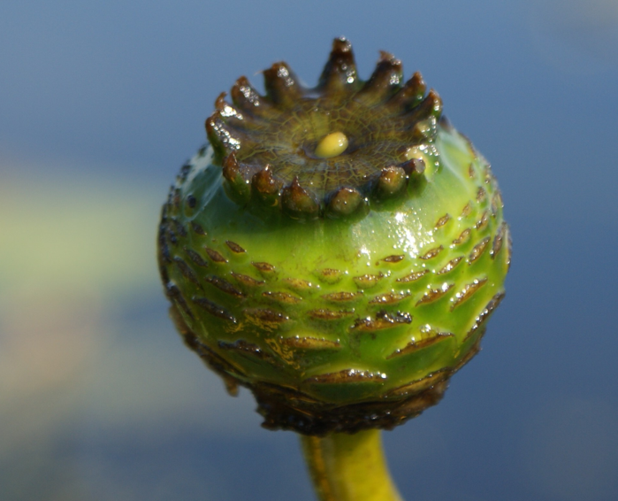
Nymphaeaceae (water-lily family)
P ∞ A ∞ G ∞
Spiral sepals, petals, androecium (gynoecium whorled/fused)
[developing fruit]
Water-lily
Nymphaea
Nymphaeaceae
Water-lily
Nymphaea
Nymphaeaceae

Slide 7
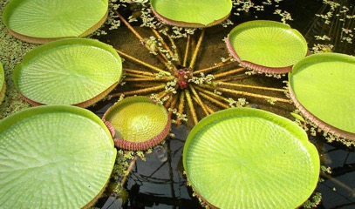
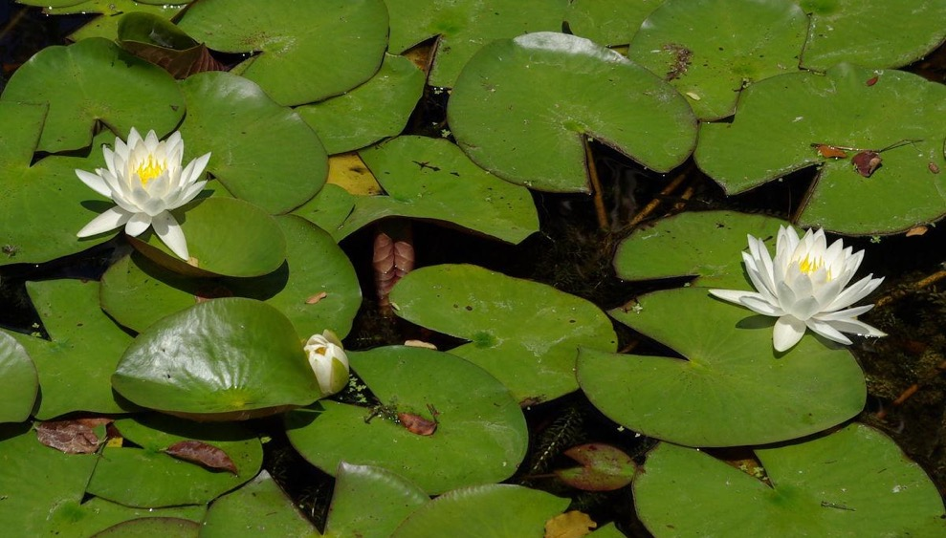
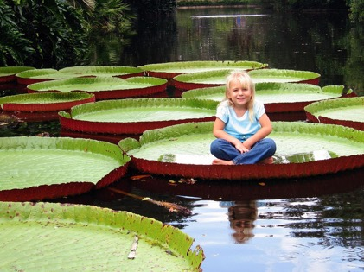
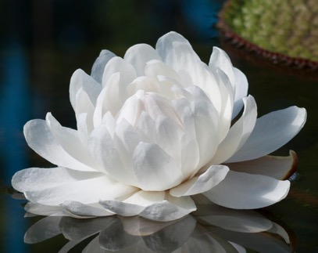
Nymphaeaceae (water-lily family)
Leaves and flowers emerge separately from rhizome
Victoria
Victoria
Victoria
Nymphaea

Slide 8
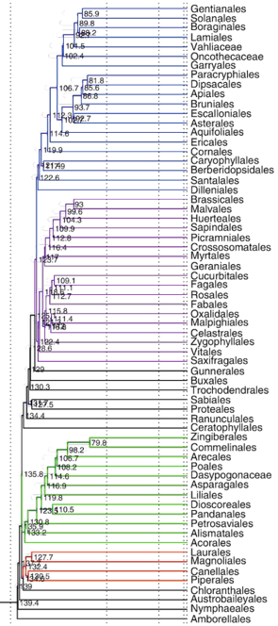
Spiral flowers in ancient plant lineages
Magnoliaceae
Nymphaeaceae

Slide 9
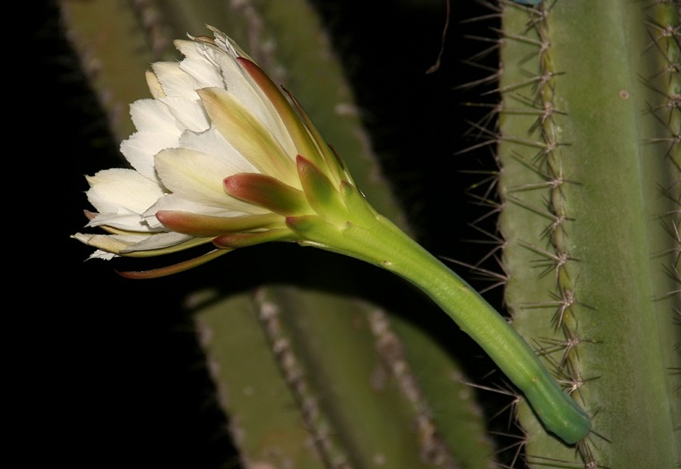
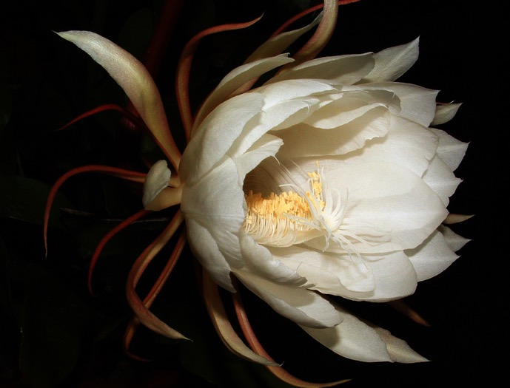
Cactaceae (cactus family)
Spiral tepals, androecium, gynoecium
Cereus
Cereus

Slide 10
Spiral flowers in more recent plant lineages
Cactaceae

Slide 11
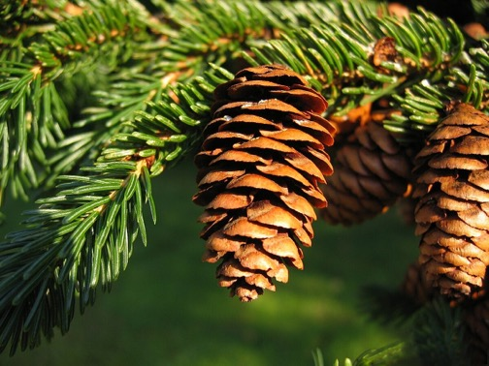
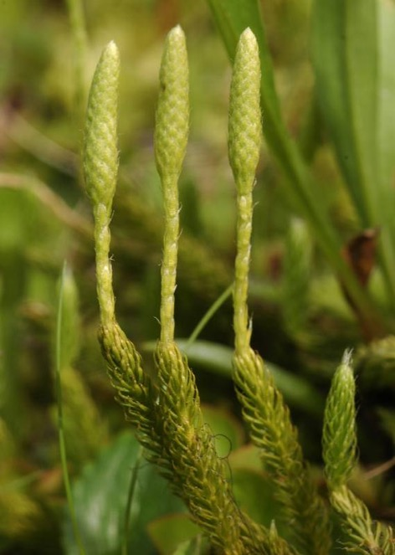
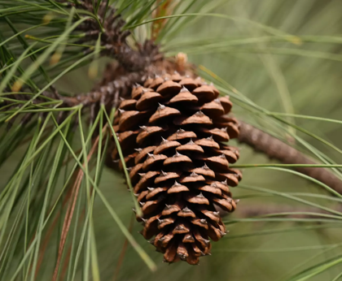
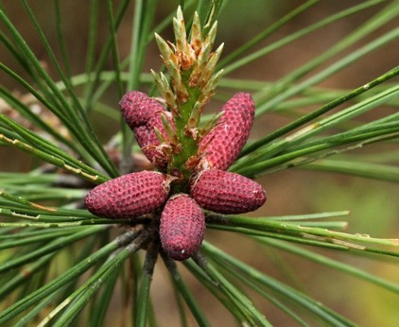
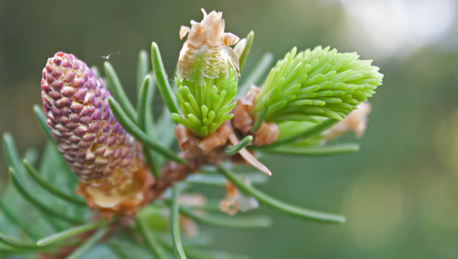
Spiral cones (non-flowering plants)
Pinaceae
seedless vascular?
Pine (Pinus) seed cone
Pinaceae
Spruce (Picea) seed cones
Pinaceae
…and pollen cone
Lycopodium spore cones
Lycopodiaceae
…and pollen cones

Slide 12
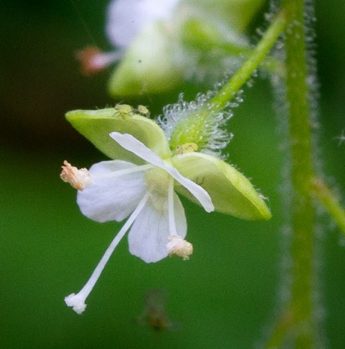
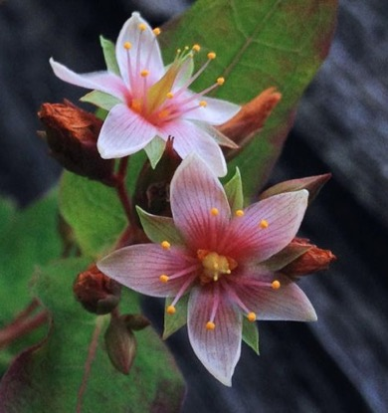
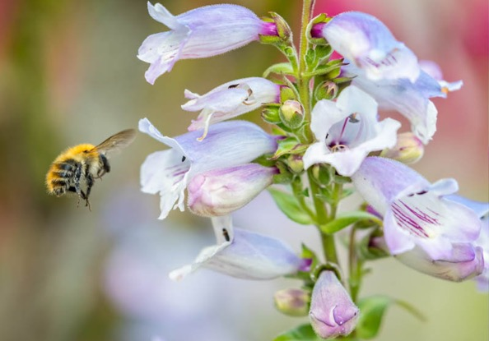
Flower variation
Numbers of organs
Positions of organs
Fusion of organs
Symmetry
Enchanter’s nightshade
Circaea
Onagraceae
St. John’s wort
Hypericum
Hypericaceae
Beardtongue
Penstemon
Plantaginaceae

Slide 13
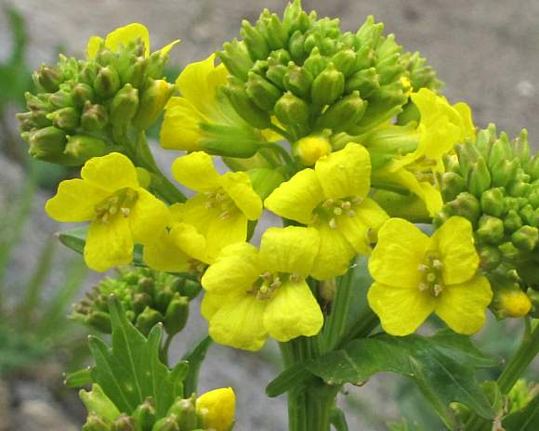
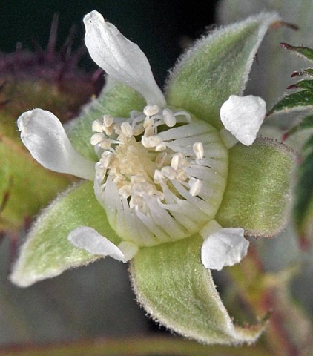
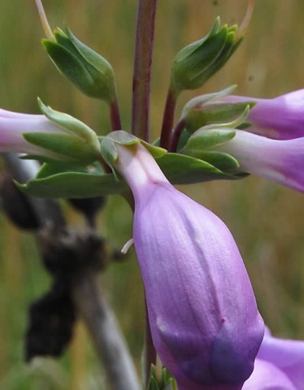
Calyx (sepals)
Often green and tougher than petals
Often serve to protect the flower bud before it opens
Often still present during fruiting phase
Winter-cress
Barbarea
Brassicaceae
Raspberry
Rubus
Rosaceae
Beardtongue
Penstemon
Plantaginaceae

Slide 14
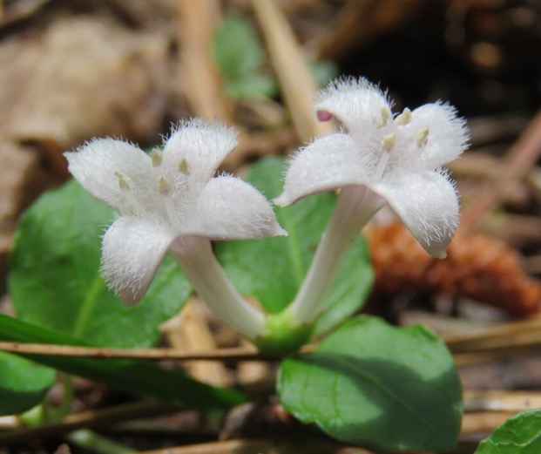
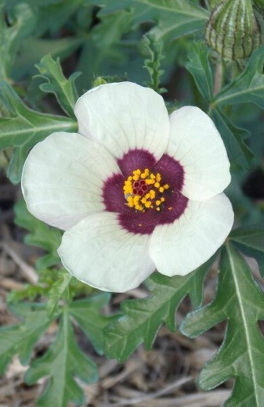
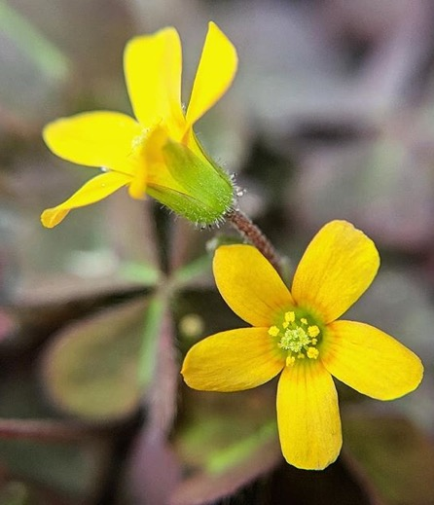
Corolla (petals)
Typically showy to attract animal pollinators
…may be reduced or absent in wind-pollinated flowers
Partridge-berry
Mitchella
Rubiaceae
Flower-of-an-hour
Hibiscus
Malvaceae
Wood-sorrel
Oxalis
Oxalidaceae

Slide 15
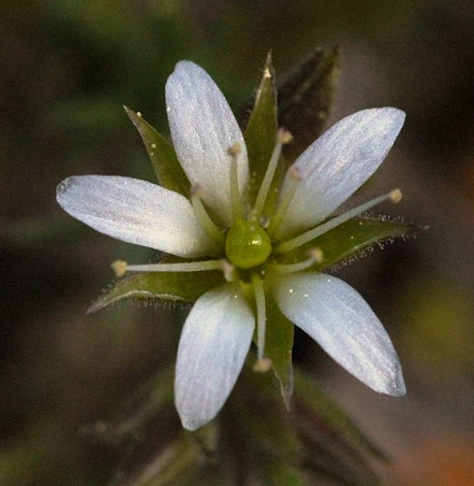
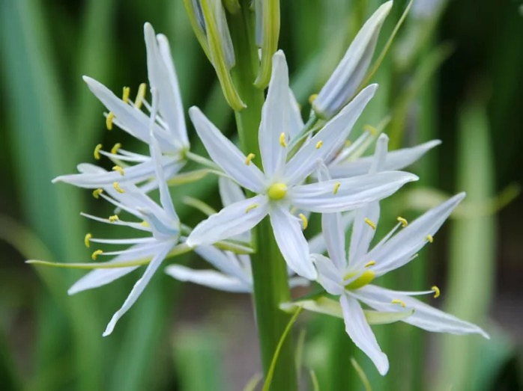
Perianth organ number
One of the more useful traits for identifying families
Sepal number usually equal to petal number
[5 sepals 5 petals]
[6 tepals]
Sandwort
Sabulina
Caryophyllaceae
Camas
Camassia
Asparagaceae

Slide 16
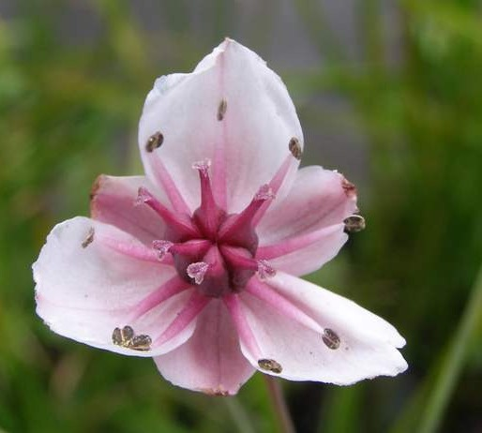
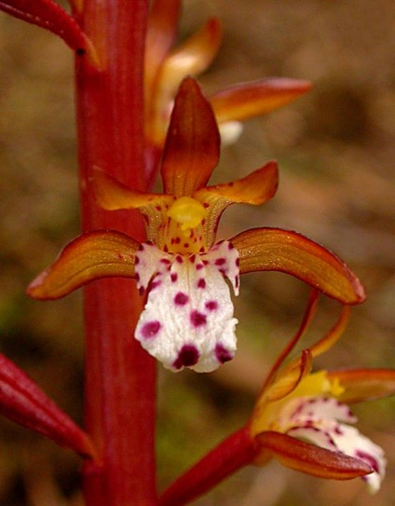
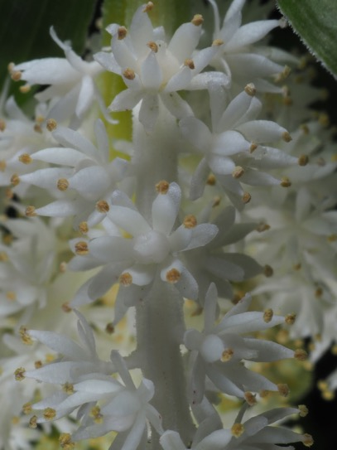
Monocots: perianth (if showy) in 3s
Often 6 tepals instead of 3 sepals + 3 petals
Flowering rush
Butomus
Butomaceae
Coralroot
Corallorhiza
Orchidaceae
False-seal
Maianthemum
Asparagaceae

Slide 17
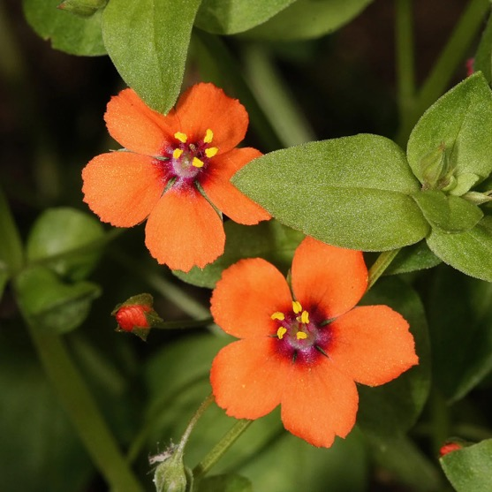
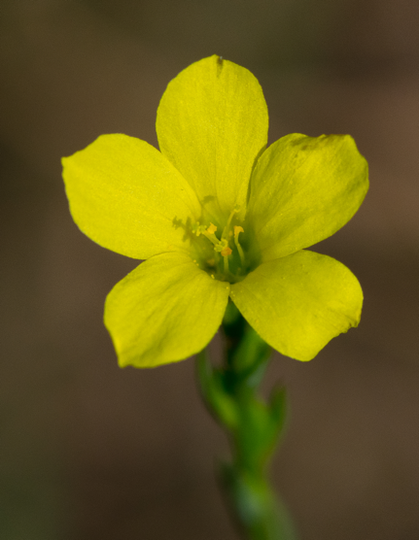
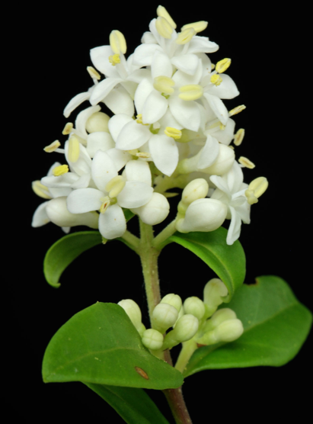
Dicots: perianth in 4s or 5s
Multiples of 5 are more common
Scarlet pimpernel
Primula
Primulaceae
Flax
Linum
Linaceae
Privet
Ligustrum
Oleaceae

Slide 18
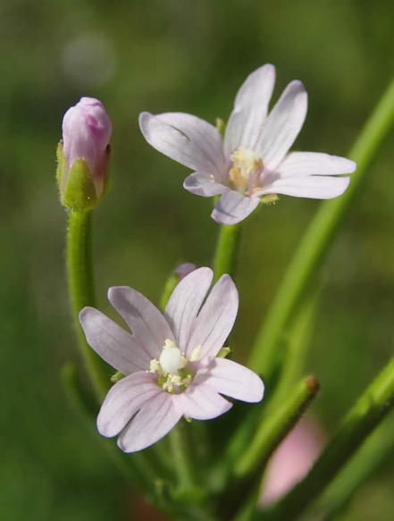
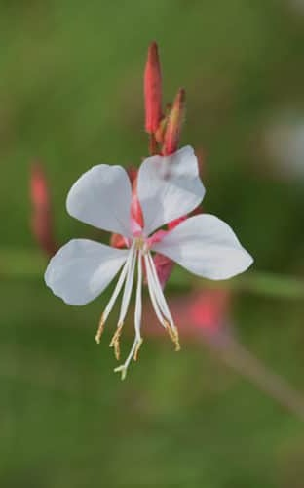
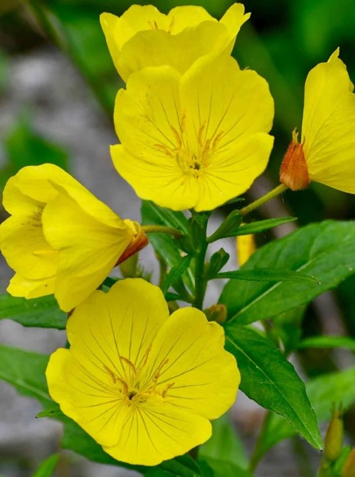
Onagraceae (evening primrose family)
Perianth in 4s
Willow-herb
Epilobium
Onagraceae
Beeblossom
Oenothera
Onagraceae
Evening-primrose
Oenothera
Onagraceae

Slide 19
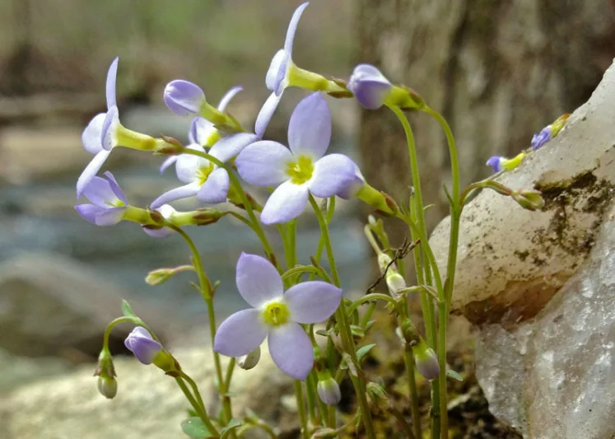
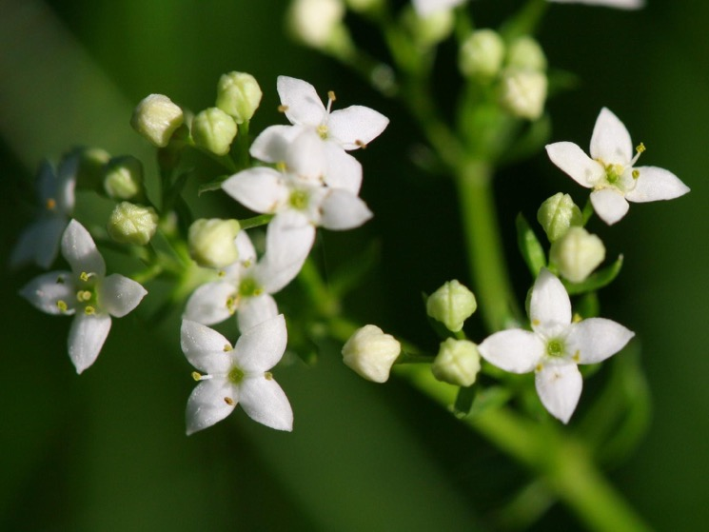
Rubiaceae (coffee family)
WI plants frequently in 4s
Bluets
Houstonia
Rubiaceae
Bedstraw
Galium
Rubiaceae

Slide 20
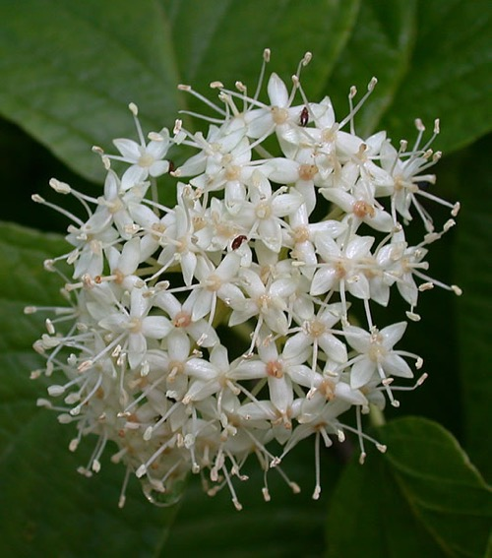
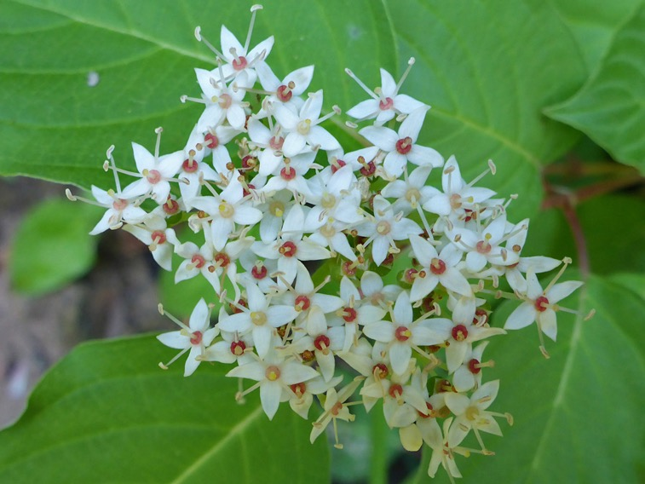
Cornaceae (dogwood family)
Perianth in 4s
Dogwood
Cornus
Cornaceae
Dogwood
Cornus
Cornaceae

Slide 21
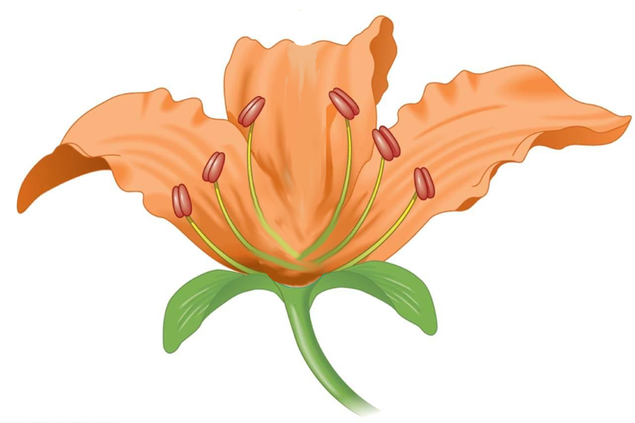
Androecium
…made up of stamens
Pollen (inside)
Stamen
Anther
Filament

Slide 22
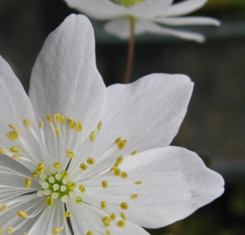
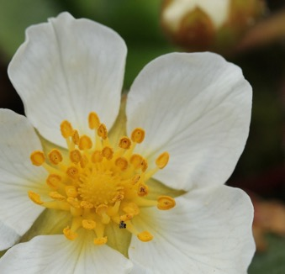
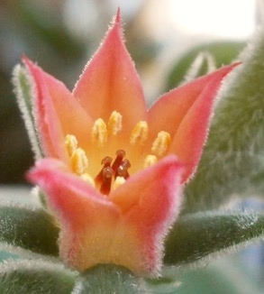





Androecium (stamens)
Meadow rue
Thalictrum Ranunculaceae
Strawberry
Fragaria Rosaceae
Echeveria Crassulaceae
Mallow
Malva
Malvaceae
Plantain
Plantago Plantaginaceae
Grass
Poaceae
Trout-lily
Erythronium
Liliaceae
Meadow rue
Thalictrum
Ranunculaceae
[many flowers together]
[many flowers together]

Slide 23



Stamen anatomy
Anther cross-section
Jaltomata (Solanaceae)

Slide 24


Stamen number
Often a multiple of perianth number
Sand-spurry
Spergularia
Caryophyllaceae
Yellow star grass
Hypoxis
Hypoxidaceae

Slide 25


Brassicaceae (mustard family)
Perianth in 4s but 6 stamens
* K 4 C 4 A 6 G 2
Yellow rocket
Barbarea
Brassicaceae

Slide 26


Oleaceae (olive family)
Perianth in 4s but 2 stamens
* K 4 C 4 A 2 G 2
Privet
Ligustrum
Oleaceae
Forsythia
Oleaceae

Slide 27

Numerous stamens
Previous families with ∞ stamens: Cactaceae, Nymphaeaceae, Magnoliaceae
Water-lily
Nymphaea
Nymphaeaceae
Tulip-tree
Liriodendron
Magnoliaceae

Slide 28



Rosaceae (rose family)
Perianth in 5s, ∞ stamens
Always K 5 C 5
Hawthorn
Crataegus
Rosaceae
Agrimony
Agrimonia
Rosaceae
Strawberry
Fragaria
Rosaceae

Slide 29


Ranunculaceae (buttercup family)
Perianth in 5s (mostly), ∞ stamens
Sometimes K 5 C 5, sometimes P ∞ tepals
Liver-leaf
Hepatica
Ranunculaceae
False rue-anemone
Enemion
Ranunculaceae

Slide 30


Hypericaceae (St. John’s wort family)
Perianth in 5s, ∞ stamens
Capsule fruit, leaves opposite
St. John’s wort
Hypericum
Hypericaceae
…maybe not always so many stamens
St. John’s wort
Hypericum
Hypericaceae

Slide 31
Gynoecium
…made up of carpels
Multiple carpels often fused into ‘pistil’
Stigma
Style
Ovary
Pistil =
fused carpels
Ovule

Slide 32





Carpel fusion
One of the more useful identification features
Number of stigma lobes often indicates carpel number
Pelargonium
Geraniaceae
Diplacus
Phrymaceae
Three separate carpels
One carpel
Three fused carpels
Trillium
Melanthiaceae
Oenothera
Onagraceae

Slide 33



Carpel evolution
Caltha (Ranunculaceae)
Ranunculus achenes

Slide 34



Carpels and pistils
Geranium
(Geraniaceae)

Slide 35



Carpel fusion
Monocarpous (unicarpellate) / apocarpous / syncarpous
Honey locust
Gleditsia
Fabaceae
Stonecrop
Crassula
Crassulaceae
‘Geranium’
Pelargonium
Geraniaceae

Slide 36



Most plants are syncarpous
Stigma number can tell you how many carpels are fused together
Mountain rice-grass
Piptatherum
Poaceae
Venus’ looking-glass
Triodanis
Campanulaceae
Evening-primrose
Oenothera
Onagraceae

Slide 37




Syncarpous / apocarpous floral formulas
Circle around ‘G’ indicates fusion
Geum
Rosaceae
Erythronium
Liliaceae
K 5 C 5 A ∞ G ∞
P 6 A 6 G 3

Slide 38



Fabaceae with unicarpellate flowers
Not easily seen in most flowers because carpels are concealed by petals
…but fruit type is from a single carpel (more on this later)
Honey locust
Gleditsia
Fabaceae
Black locust
Gleditsia
Fabaceae
Bird-foot trefoil
Gleditsia
Fabaceae

Slide 39


Rosaceae with unicarpellate flowers
Genus Prunus: cherries / plums / peaches
Only one style, maybe hard to discern among stamens
Cherry
Prunus
Rosaceae
Cherry
Prunus
Rosaceae

Slide 40
Apocarpous: Magnoliaceae
Magnolia
Magnoliaceae
Tulip-tree
Liriodendron
Magnoliaceae

Slide 41


Apocarpous: Ranunculaceae
Bower
Clematis
Ranunculaceae
Buttercup
Ranunculus
Ranunculaceae

Slide 42


Apocarpous: Rosaceae
Blackberry
Rubus
Rosaceae
Avens
Geum
Rosaceae

Slide 43


Organs most often are alternate
i.e., petals fall in between the sepals, stamens in between the petals
In Primulaceae, stamens are opposite the petals
Storks-bill
Erodium
Geraniaceae
Scarlet pimpernel
Primula
Primulaceae

Slide 44


Stamens opposite petals: Primulaceae
Creeping Jenny
Lysimachia
Primulaceae
Water pimpernel
Samolus
Primulaceae

